Slide 1
Bachelor Thesis I / Project Work II
WebRTC
Development of a browser based real-time peer-to-peer remote support application
Michael Stifter

Slide 2
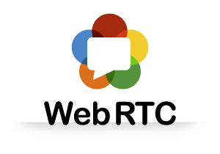
Notes:
WebRTC stands for Web Real-Time Communication.
It enables you to communicate with others via voice calling, video chat or P2P file sharing.
Now, you might be asking yourself: „That‘s great, but I already have Skype and a dozen other applications for that. Why would I need WebRTC?“

Slide 3


Notes:
If you want to communcate with someone over traditional chat applications, all the traffic goes over a web server.
With WebRTC, however, only the initiation of the conversation happens via a web server. Once the session has been established, all data goes directly from browser-to-browser. This is called peer-to-peer.

Slide 4


Notes:
Advantages:
It‘s free
No external plugins needed – platform and device independence
WebRTC enforces the use of encryption for both media and signalling
For companies: Communication with customers directly through web page
For developers: Standardized APIs – no special knowledge about network connection, media stream necessary. A bit of Javascript knowledge will be helpful, though ;-)
Disadvantages:
Still in development: Browser prefixes, APIs might change
In order to communicate peer-to-peer, it is necessary to know the public IP address of the users. Through Network Address Translation (NAT), this could become problematic. The solution for that is to use STUN and TURN servers.
As long as it‘s only two parties, it‘s really simple, but from then it gets complicated. An MCU is needed.
Browser compatiblity

Slide 5
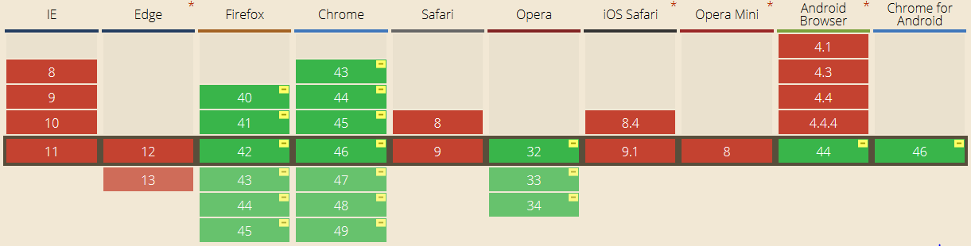
as of November 2015
Notes:
Google Chrome, Mozilla Firefox and Opera
Microsoft and Apple are currently not interested in WebRTC. Bad news for Mac users!

Slide 6
Remote support application
Notes:
Advantages:
Experts can consult without being physically there
Malfunctions can be repaired quicker, by on-site personnel

Slide 7



Slide 8
Thanks for your attention!

